Slide 1
Sports club management system
The following presentation is a basic guideline to Sport Club Management.
It is a detailed guideline from the formation of a sport club including all administration work and financial requirements to the organization of tournaments.
By the simple application of these guidelines, an individual can start a basic sports club which could compete at a competitive level against other such clubs.

Slide 2
ABSTRACT
Managing an amateur sporting club is most often time consuming and tedious. Netball, baseball, football, hockey, basketball to name but a few, present the very same challenges.
Simple but efficient systems to handle administration and day to day running of any club are essential to avoid draining valuable resources, both time and money.
Sports Club Management Software has been designed to help organize and manage, and, to reduce time-consuming administration in key areas of Membership, Finances and Competition. With no more than a few mouse clicks, club information is available, ready to communicate to others.
Sports Club Management Software records information on membership, dues, game schedules etc in database format. Comparing to an equivalent manual recording system, the time saved without duplication is enormous.

Slide 3
ACTIVITIES OF THE CLUB
Recruiting members , organizing meetings , organizing activities
Allocation of rooms, grounds
Selection of main players for the tournament
Providing kits
Baring expenses
Undertaking fests and tournaments related to sports only

Slide 4
MEMBERS UNDER THE CLUB
Director
Physical education in-charge
Physical education trainer
Workers , umpires , healthcare providers
Coaches
players

Slide 5
EXISTING SYSTEM
• There is no existing system. All the Information’s are handled manually in the Registers or other documents. • Existing systems handle the multiple locations but not at time information analyze to data. • The duration of particular entries is in particular time or places. • Communication between Member and any club is done by either via Telephone or face to face.

Slide 6
PROPOSED SYSTEM
• This website is used to provide the online sports grounds. • This site is use to register the Member for the member ship online. • Member can easily get information about grounds at a home. • Admin can manage all the events and it’s news through email send to our member. • User can also view the photos of grounds. • No need of any extra manual effort. • Admin can manage the Games Event and Members.

Slide 7
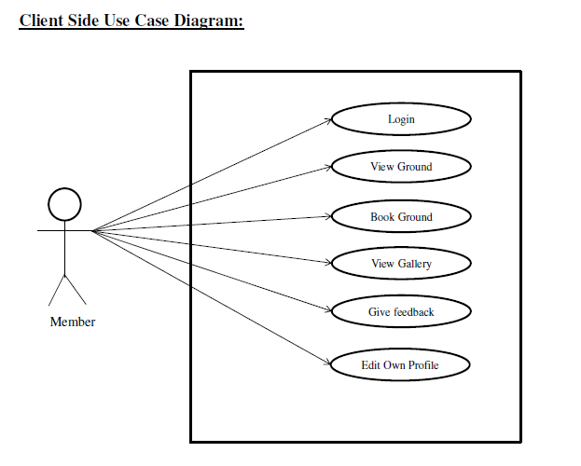
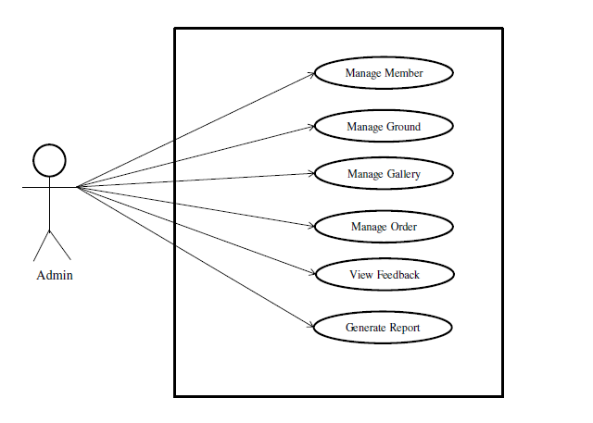
USE CASE DIAGRAMS

Slide 8
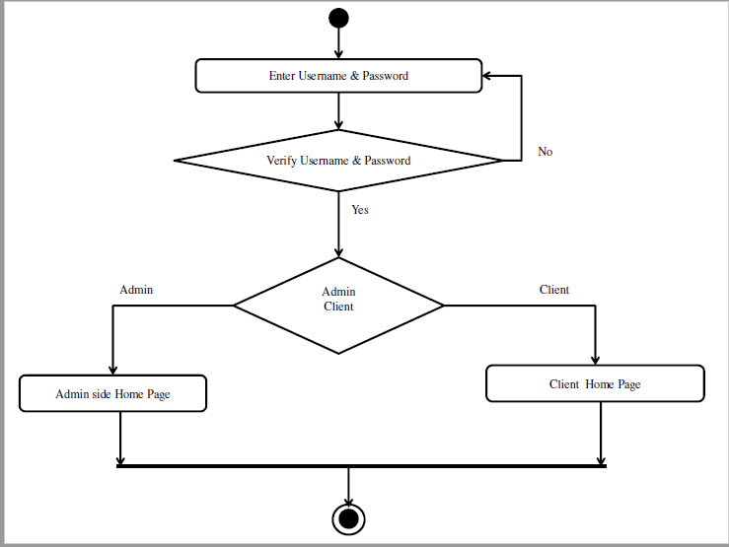
GENERAL ACTIVITY DIAGRAM

